Slide 1
Benchmarking Project, SBMI 5332 – Stats Genomic Data
Ben Mescher, Spring 2020
Bhuva, D.D., Cursons, J., Smyth, G.K. et al. Differential co-expression-based detection of conditional relationships in transcriptional data: comparative analysis and application to breast cancer. Genome Biol 20, 236 (2019). https://doi.org/10.1186/s13059-019-1851-8

Slide 2
Overview: Co Expression Analysis
Differential expression analysis is used to discover gene expression changes across varying conditions or phenotypes (e.g. disease vs. healthy samples)
Gene set analysis methods – use known associations (sets of genes) to determine if genes with similar expression profiles are independent or coordinated
Gene Regulatory Network inference methods – look for functional info using a single condition (not a comparison of different conditions)
E.g. WCGNA, z-Score (Prill)

Slide 3
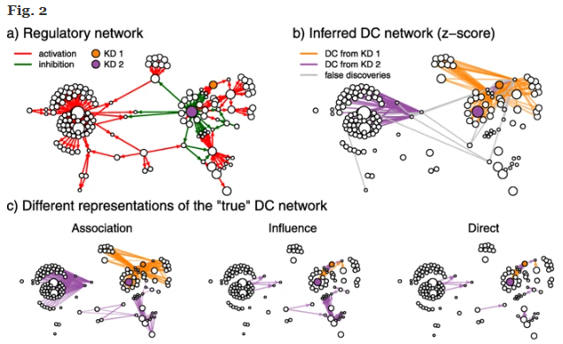

Slide 4
Overview: Differential Co-Expression
“differential association”, “differential correlation”, “differential network”
Look for coordinated gene expression changes that vary in different conditions (so called ‘conditional regulatory relationships’)
The objective is to identify regulatory relationships amongst genes that change across conditions
A key underlying idea is that regulatory networks can change in different biological contexts (such as healthy vs. cancerous tissue)

Slide 5
Differential co-expression-based detection of conditional relationships in transcriptional data: comparative analysis and application to breast cancer. (Bhuva, D.D., Cursons, J., Smyth, G.K. et al.)
Create expression data for regulatory networks where some genes are simulated to behave differently in two different sampling conditions
Benchmark a handful of differential co-expression methods on the simulated data
Identify relevant network properties and parameters of the top performers

Slide 6
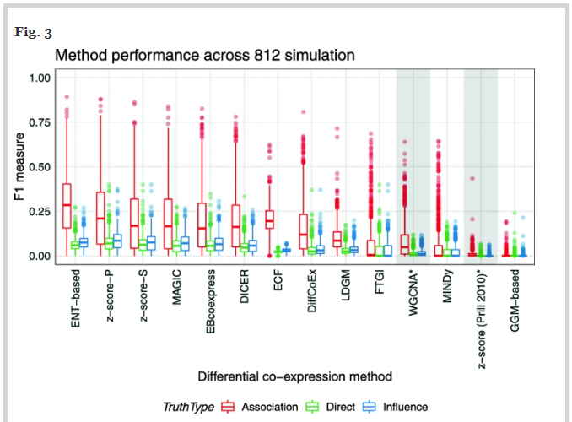
Target Figure to Reproduce
Compares performance of 11 differential co-expression methods
812 sets of simulated expression data: ~500 observations

Slide 7
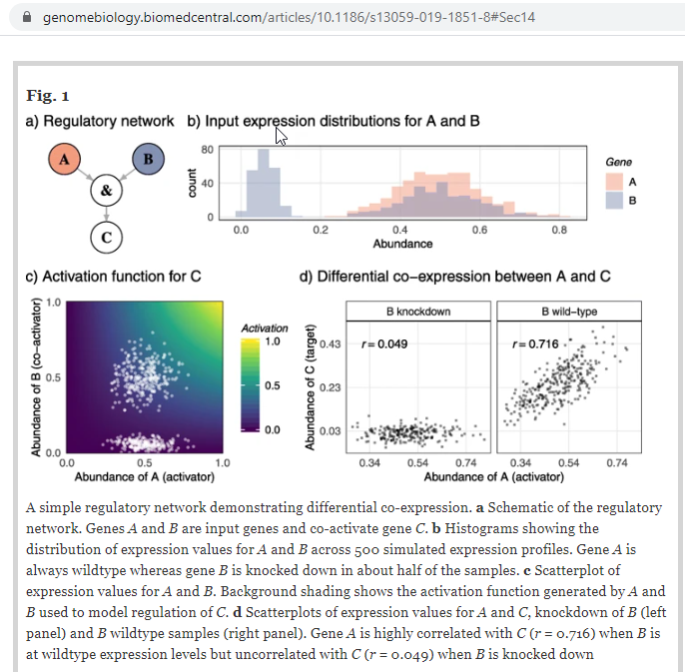

Slide 8
Differential co expression Methods
The objective is to identify regulatory relationships amongst genes that change across conditions
A key underlying idea is that regulatory networks can change in different biological contexts (such as healthy vs. cancerous tissue)
Four main types of methods:
Gene base – pairwise gene comparisons
Module based – use known gene associations and relationships
Biclustering – cluster rows (to create gene modules) and on columns (different samples)
Network based – output a single network for all conditions

Slide 9
Methods | Gene Regulatory Network inference | Differential co expression
Alternative |  | “differential association”, “differential correlation”, “differential network”
Examples | WCGNA, z-Score (Prill)
Looking for | Regulatory relationships | Conditional regulatory relationships
By identifying | Concordant co-expression | Discordant differential co-expression (genes that are

Slide 10
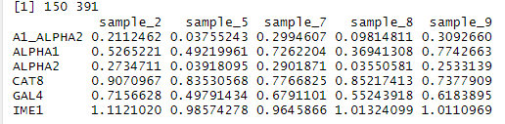
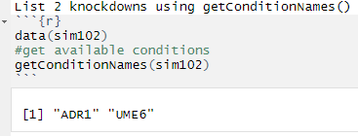
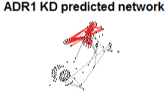
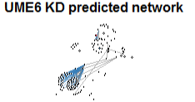
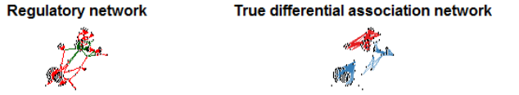
Data
812 simulated gene expression datasets
Each dataset: ~500 samples from a simulated regulatory network containing 150 genes
2-8 of the genes in each dataset are “knockdown” genes that behave differently across 2 different sampling conditions
Relationships between the simulated genes can be plotted as iGraph objects in R:

Slide 11
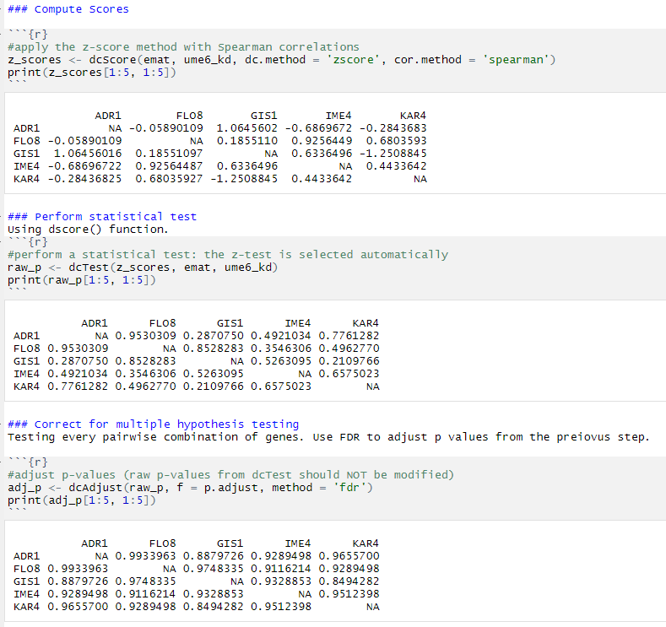
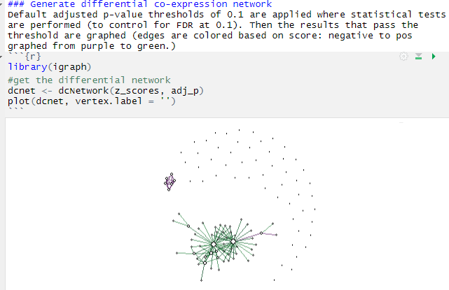
Results – Network Prediction
Can use the dcanr package (described in Bhuva, et al.) to apply Diff. Co-Expression methods to the simulated data
Can apply statistical tests to the results, use a threshold to select significant “edges” and build a predicted mmodel of the network

Slide 12
Results – Evaluation of Different Methods
As described in Bhuva, et al., there are different degrees of “truth” when it comes to compiling edges on a differentially co-expressed regulatory network:
1. Direct - this represents direct TF-target regulatory interactions that are affected by the knock-down (condition)
2. Influence - this network includes upstream TF-target interactions which are indirect but causative
3. Association - this network includes all associations in the influence network but adds all non-causative associations that are differential when conditioned on the knock-down

Slide 13
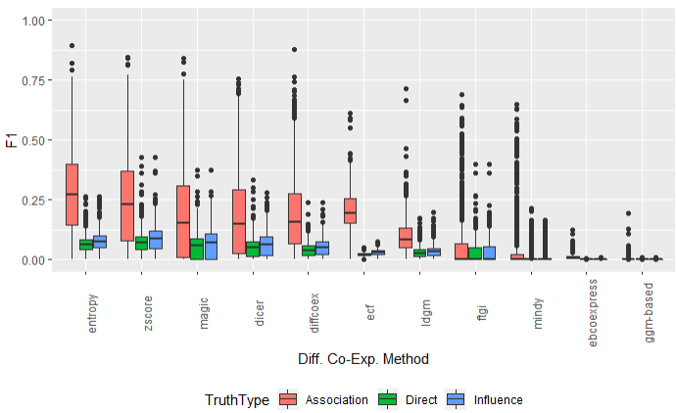

Results – Evaluation of Different Methods

Slide 14
Target Figure to Reproduce
Compares performance of 11 differential co-expression methods
812 sets of simulated expression data: ~500 observations

Slide 15
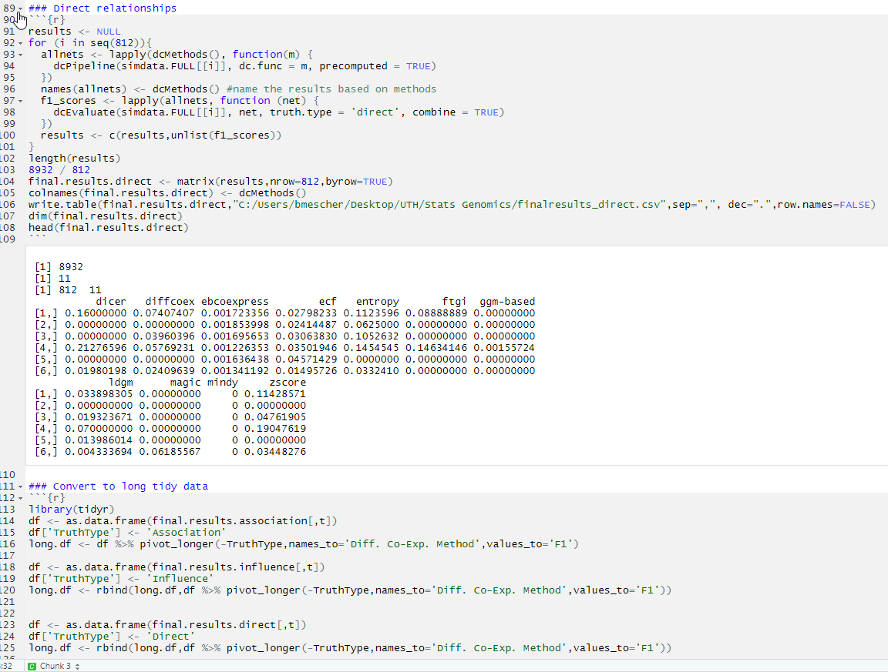

Slide 16
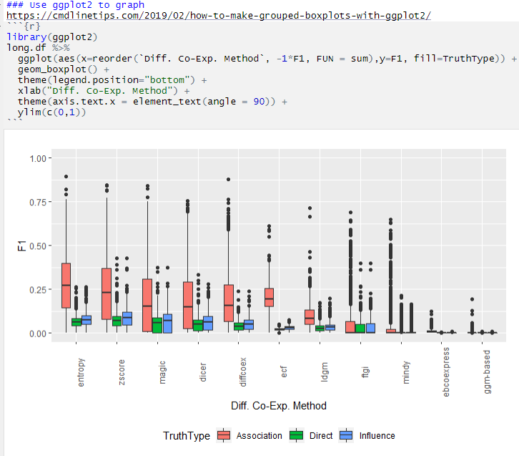

Slide 17
Conclusion
Algorithms specifically designed for co-expression analyses (looking for concordant expression differences) did not perform well in differential co-expression analyses (looking for discordant expression differences)
No universally better-performing method. Affected by:
Samples sizes (some methods are better with smaller sample sizes)
Class balance (some methods are better with imbalanced classes)
Real world data may be more imbalanced [have more disease samples than healthy])
Network properties (e.g. average number of input nodes into the target knockdown genes)

Slide 18
Bhuva, D.D., Cursons, J., Smyth, G.K. et al. Differential co-expression-based detection of conditional relationships in transcriptional data: comparative analysis and application to breast cancer. Genome Biol 20, 236 (2019). https://doi.org/10.1186/s13059-019-1851-8

